Slide 1
The Matrix
Presented by: Elizabeth, Kaleb, Emma, Phil, and Adam

Slide 2
Cinematography and Lighting
Presented by Elizabeth Astbury

Slide 3
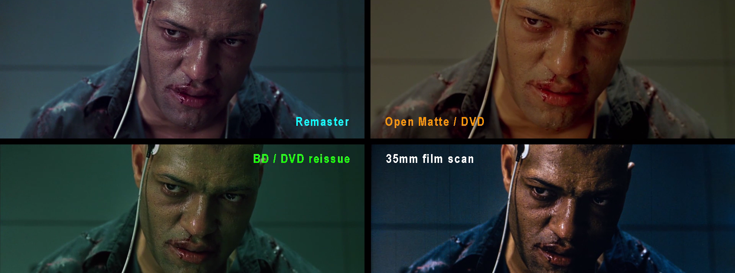
LIGHTING IN THE MATRIX
Grey and green lighting is important.
The lighting causes other colours to pop.
Remasters of the film have caused controversy.

Slide 4
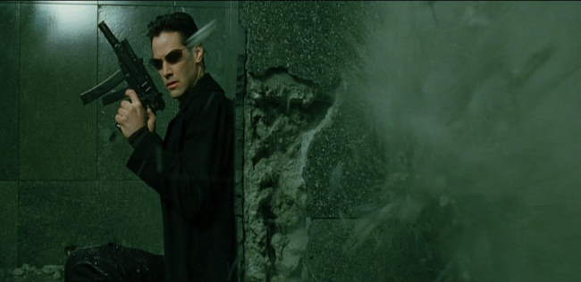
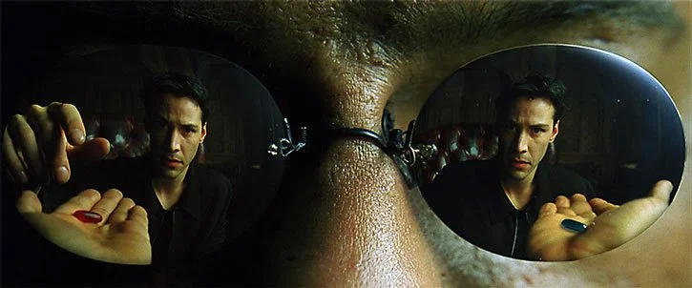
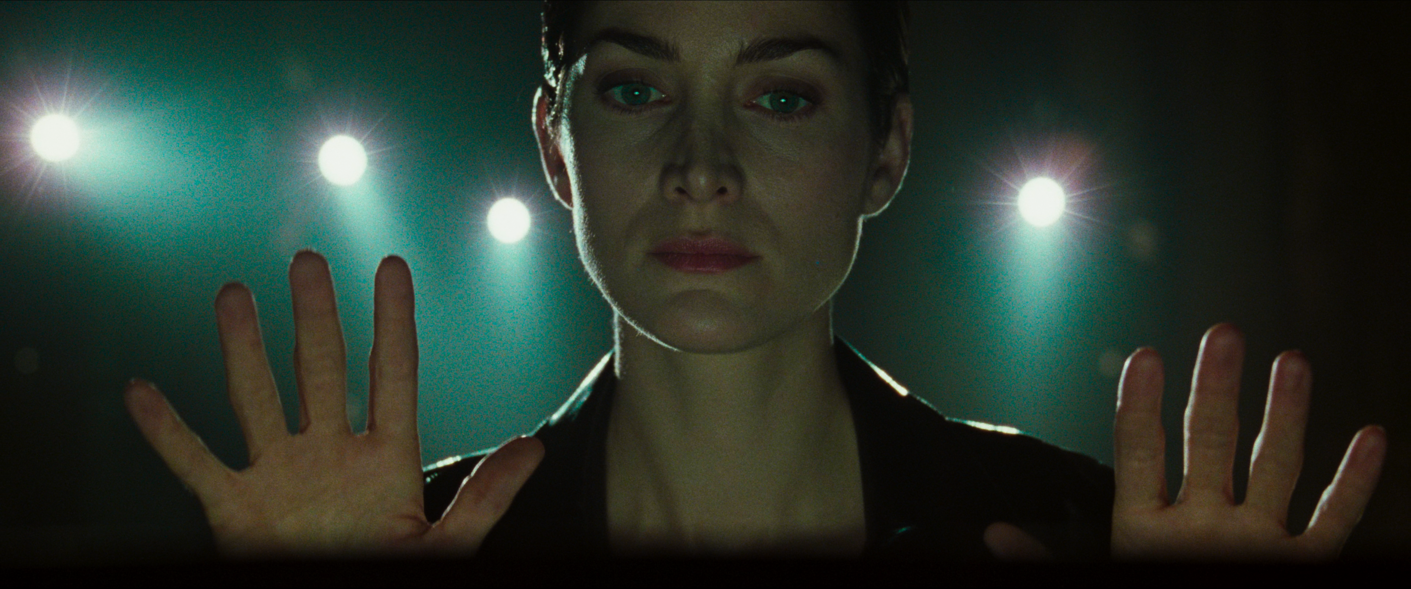
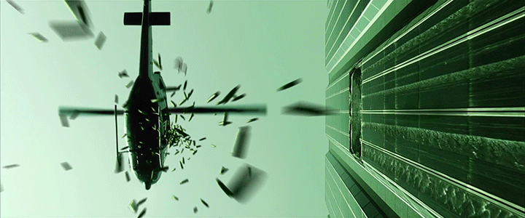

Slide 5
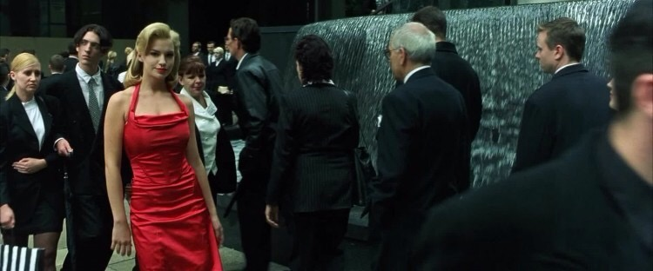
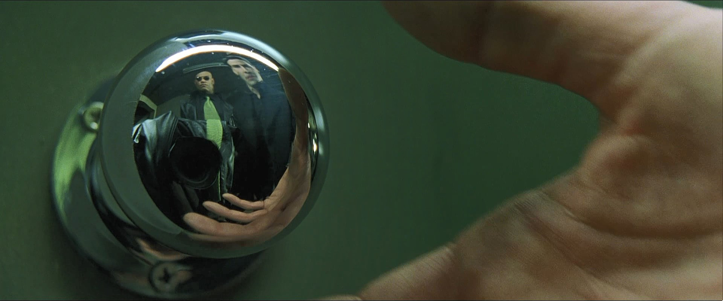
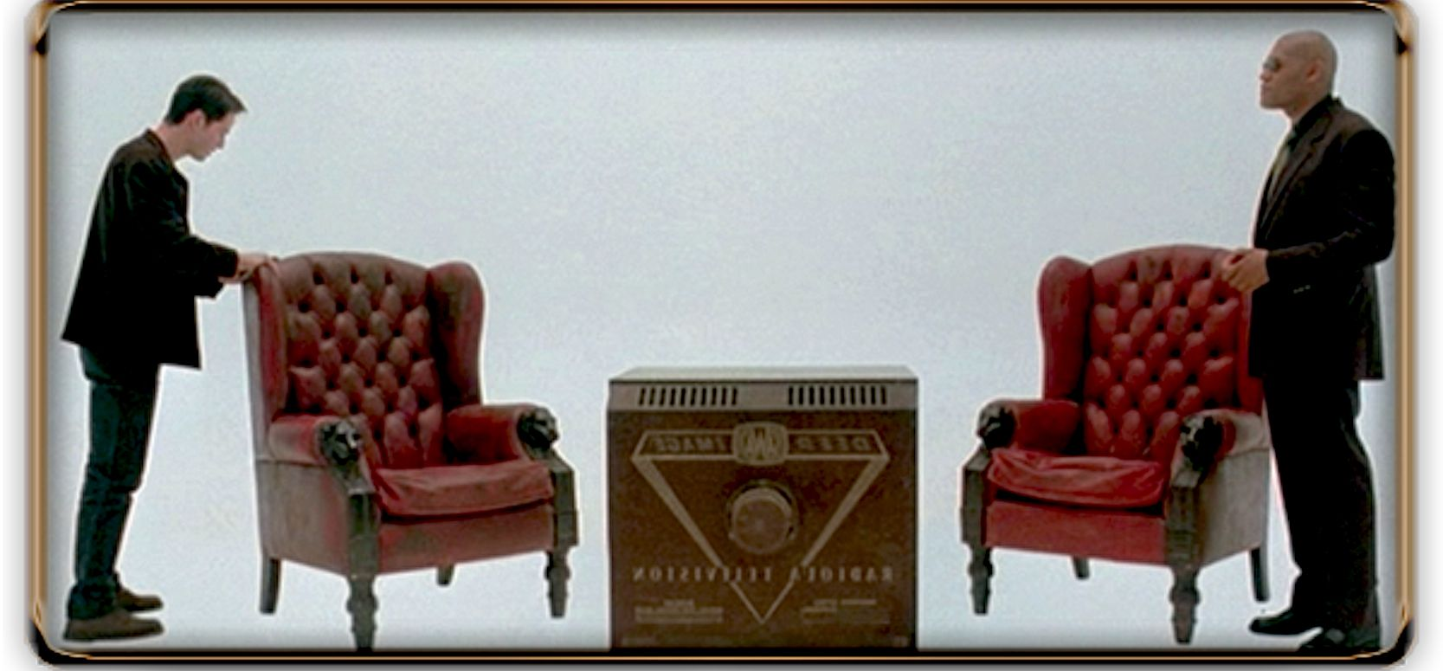
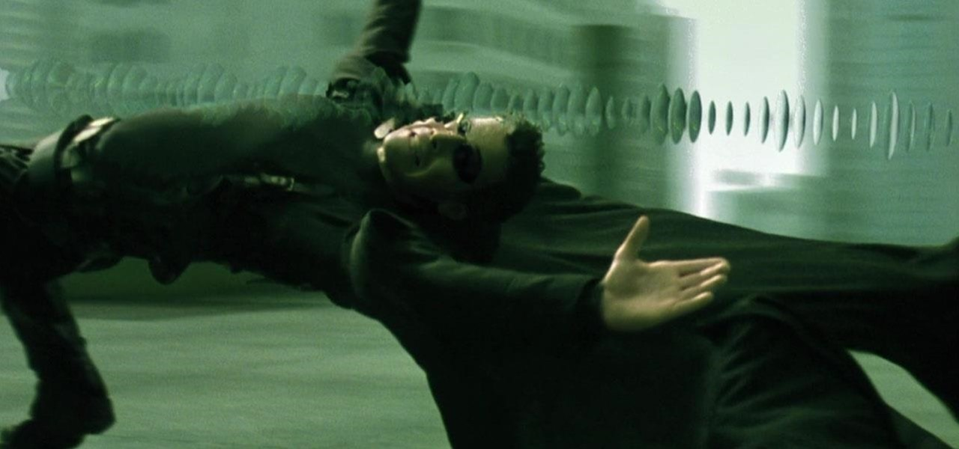

Slide 6
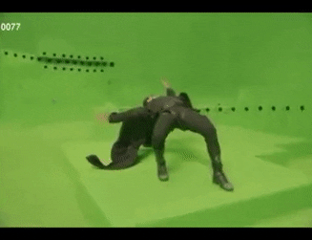

Slide 7
The Matrix CGI/Special Effects
Presented by: Kaleb Riopel

Slide 8
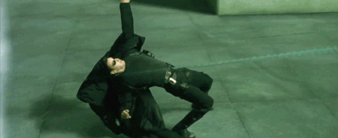
Bullet Time

Slide 9
How was Bullet Time filmed?
Multiple still cameras
Filmed in real time
Cameras recording sequentially
Adding of frames to increase the quality of the effect

Slide 10
Why Bullet Time Versus Slow-Motion
Restriction of camera angles
Allows for a more immersive scene
Easier to edit and more creative freedom

Slide 11

Editing
Emma Lavigne

Slide 12

Editing – The Opening
Graphic match / match cut
Used to relate two otherwise disconnected scenes
Establish a relationship between the two scenes
Relationship between code and where the officers are
Notes:
Take Neo’s (Mr Anderson’s) room for example

Slide 13
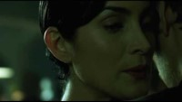
Editing – The Club
In:
Sharp cut
Used to contrast Neo’s “world” by cutting to the exact opposite
Music
At the end of the scene music is used for an effective transition
Seems to be a part of the music → ends up being his alarm clock
Mantra
Dreaming
Out:
Notes:
Take Neo’s (Mr Anderson’s) room for example

Slide 14
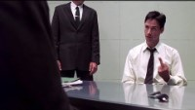
Editing – Interrogation
Like the club transition
Match on action
Used in continuity editing that cuts two alternate views of the same action together at the same moment
First action → bug goes in
Second action → waking up
Linked with scream and action
Mantra
Dreaming
Notes:
Take Neo’s (Mr Anderson’s) room for example

Slide 15
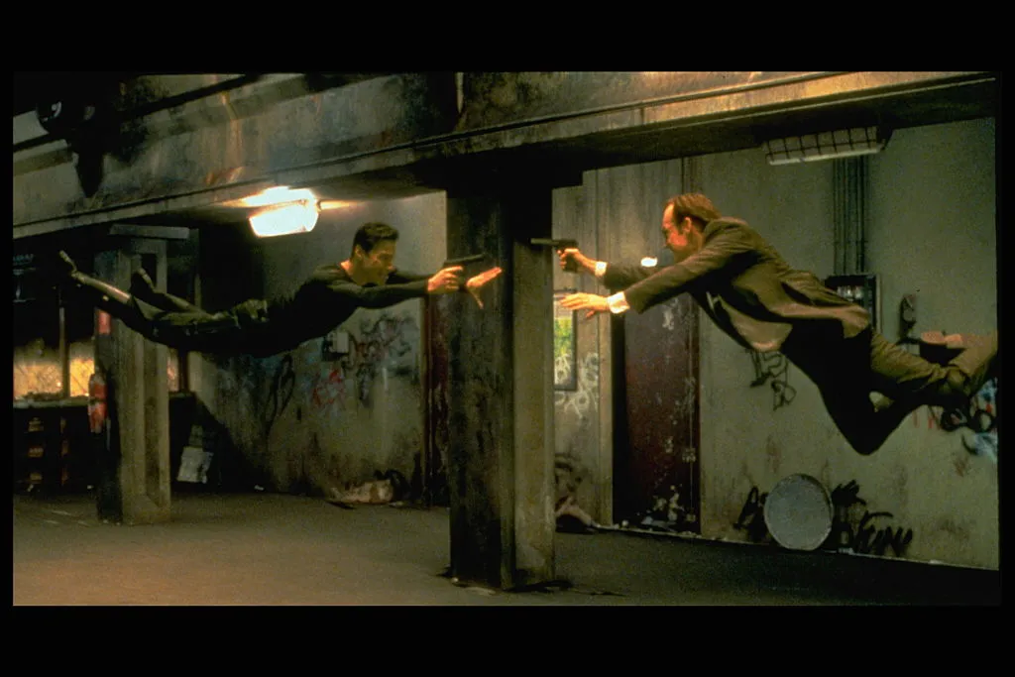
Set Design
Set design in the matrix is very reminiscent of the late 90s and early 2000.
Setting the atmosphere of the movie.
Throughout most of the movie. Scenes take place all over the city. Taking place inside or outside of buildings, roof tops and roof tops.
Notes:
Take Neo’s (Mr Anderson’s) room for example

Slide 16
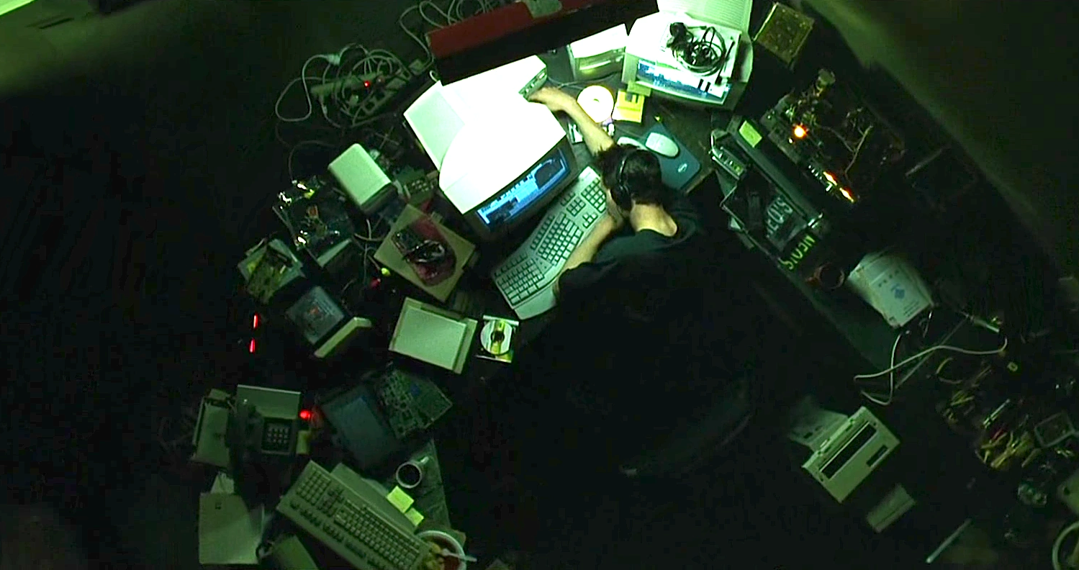
Set Design: Neo’s room
Take a look at Neo’s apartment. It’s cluttered full of objects such as keyboards, printers/fax machines, a computer and other tech.
Wires can be seen on the floor telling the viewer that: Everything is being used.
The set is designed to convey the message that Neo, aka Thomas Anderson, is a computer geek. Spending most of his time in front of his computer.
Notes:
Take Neo’s (Mr Anderson’s) room for example

Slide 17
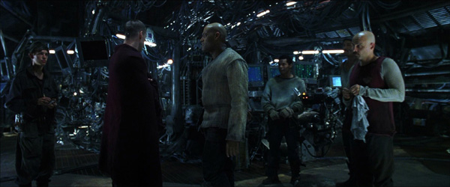
Set Design: The Nebuchadnezzar
Contrary from inside the matrix. Inside the Nebuchadnezzar. The set looks like to be inside of a submarine.
Giving a cold feeling. The walls being made of steel with tech throughout the main deck. Capable of transporting those with implants into the matrix.
This gives the atmosphere of an actual ship.
Notes:
Take Neo’s (Mr Anderson’s) room for example

Slide 18
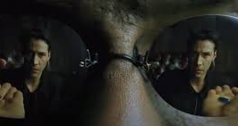
Costume Design
Characters in the matrix have recognizable costumes.
Conveying who is the protagonist and antagonist
Notes:
Take Neo’s (Mr Anderson’s) room for example

Slide 19
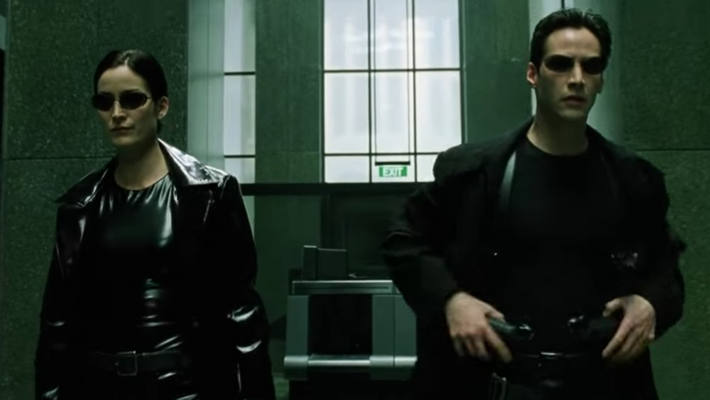
Costume Design: Crew of the Nebuchadnezzar Inside the Matrix
Neo’s group wearing all all-black tight-fitting clothing. (With the exception of Switch, who wears all white.)
The costumes are not what someone would wear everyday. Meaning civilians in the movie aren’t seen wearing this type of outfit
You can tell who they are by a quick glance. Being incredibly recognizable.
Passing on the idea that these are the main protagonist.
Notes:
Take Neo’s (Mr Anderson’s) room for example

Slide 20
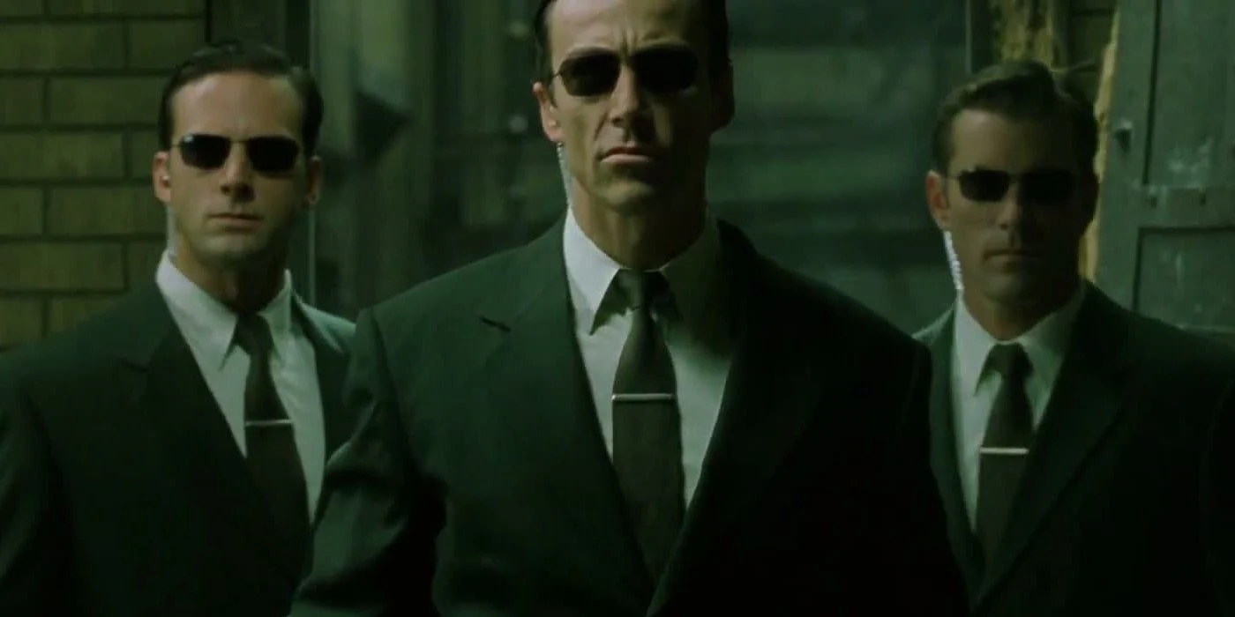
Costume Design: The Agents
Contrary to the Crew of Nubechadnezzar. The agents wear professional government looking suit. Passing off the idea of Big Brother’s goons. Found working with the police.
This conveys to the viewer that agents : Smith, Brown, and Jones are the ones who want to take down Neo.
Notes:
Take Neo’s (Mr Anderson’s) room for example

Slide 21

Choreography
Notes:
Being an action/sci-fi movie, The Matrix obviously has a lot of fight scenes. We’re used to that in film, its part of what defines the action genre after all. But where the matrix differs from other Hollywood movies of the time is in the quality and complexity of these fight scenes. the top-notch choreography in the matrix helped it become one of the most iconic films in Hollywood history.

Slide 22

Changing the Game
Before The Matrix
Explosions
Muscles
Action OR Martial arts but not both
Choppy and hard to follow
Fight Scene from Street Fighter (1994)
Notes:
Before the Matrix was released, there was a clear line between martial arts movies and action movies. martial arts were used far less frequently in mainstream films aside from dedicated martial arts movies. With most action movies relying on explosions for their more exciting scenes, rather than hand to hand combat. Afterall, who doesn’t love watching things explode right?
And when there were no explosions, main characters in action movies were often depicted as simply a huge chunk of muscle that can get past anything in their way with pure strength. Films like Rambo, despite being a great film overall show this very well.
The clip shown is from the Street Fighter movie from 1994. look how choppy and hard to follow it is, there are so many cuts that you can barely even see what they are doing. Part of what made the Matrix so revolutionary was its use realistic but exaggerated martial arts techniques that flow together in a scene so the audience can follow the scene.

Slide 23
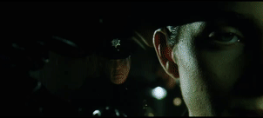
Changing the Game
After The Matrix
Emphasize on stunt work
Hand to hand combat
Subtlety in acting
Large scale action pieces
Notes:
From the very first scene in the matrix, we get a taste of what we’re in for. As Trinity shows of many well choreographed moves that work extremely well with the editing and effects in the film.
This really sets the tone for the matrix and shows how much of an emphasize they place on stuntwork and hand to hand combat.
The matrix showed the rest of hollywood that times have changed, and that well acted, and well thought out choreography could be used to make hand to hand fight scenes more interesting and engaging than just a big kaboom. Especially when paired with new technology and filming techniques showcased in the matrix

Slide 24
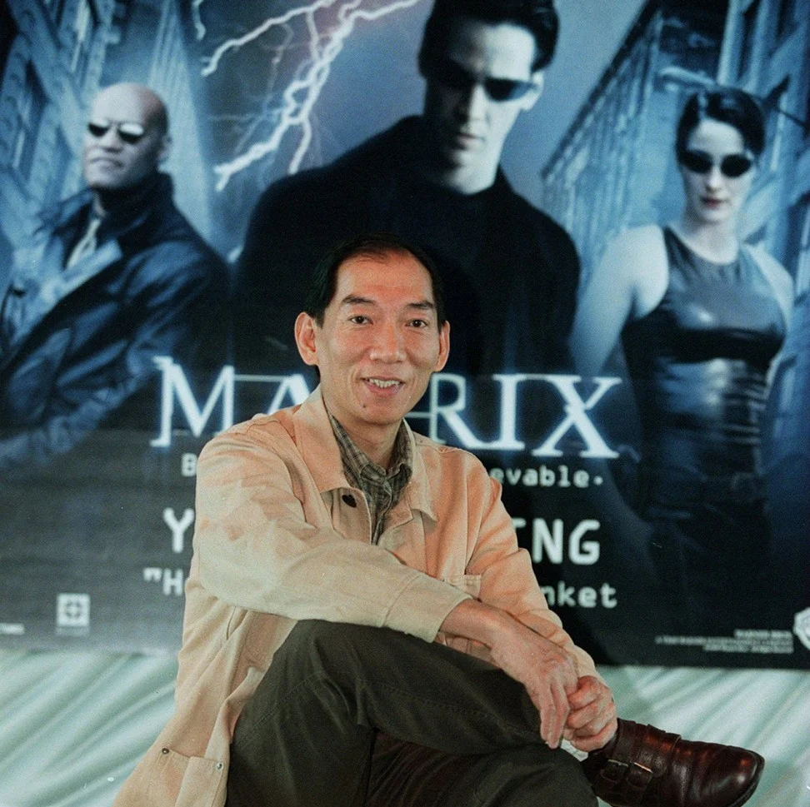
Yuen Woo Ping
Chinese Director and Fight Choreographer
Before The Matrix
Drunken Master (1978) starring Jackie Chan
Fist of Legend (1994) starring Jet Li
Lethal Weapon 4 (1998)
After The Matrix
Crouching Tiger, Hidden Dragon (2000)
Kill Bill Vol. 1 & Vol. 2 (2003/04)
Fearless (2006)
Notes:
I cant discuss the choreography in the matrix without talking about the man responsible. Yuen(yoon) Woo Ping is credited as being one of the most influential fight choreographers in film history.
Starting his career in Hong Kong cinema, Woo Ping helped skyrocket Jackie Chan’s career with the surprise hit Drunken Master in 1978. He followed up the hit with more Chinese kung fu movies until his unique style was noticed by the Wachowski’s in hollywood, who hired Woo Ping to work on The Matrix franchise.
Since then, the fighting style he helped pioneer has been prevalent in many major Hollywood films. As shown by The Matrix, this style of choreography blended seamlessly with newly emerging tech capabilities and editing styles and can even be seen in films like the avengers franchise

